Slide 1

Myntra Brand Analysis

Slide 2
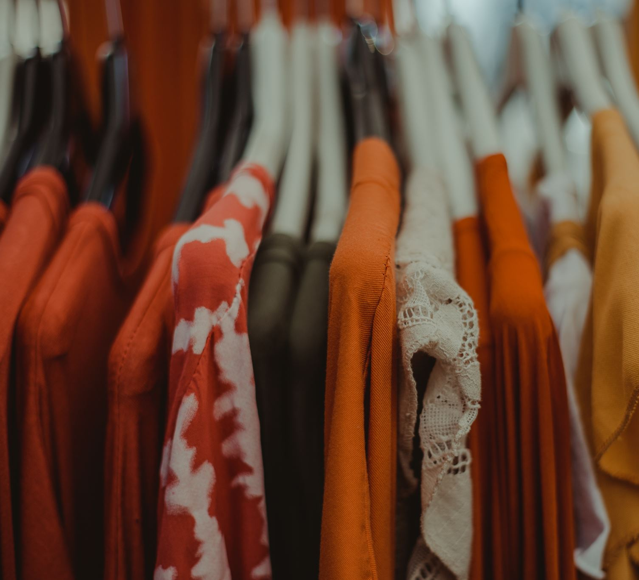
A brief introduction to Myntra
Founded in 2007 by Mukesh Bansal, Ashutosh Lawania, and Vineet Saxena.
Myntra offers a vast selection of fashion and lifestyle products, including over 5,000 brands and 600,000+ products.
Offers a wide variety of clothing, footwear, accessories, and beauty products for men, women, and children.
60 million user in a month.

Slide 3
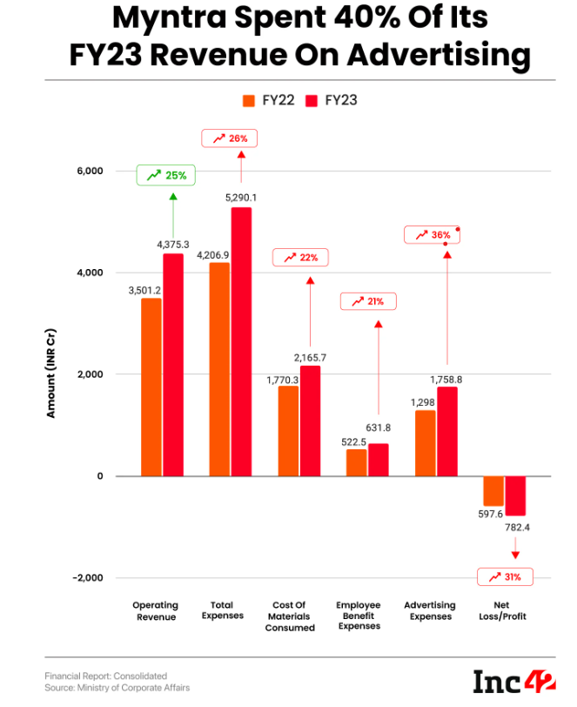
Myntra had a 31% loss at the end of fiscal year 23.
Myntra’s Revenue Model
Operating Revenue : increased by 25%
Total expenses: increased from 4206.9 cr to 5290.1 cr.
Myntra had a 31% loss at the end of fiscal year 2023.

Slide 4
Milestones achieved by Myntra
2007
2011
2014
2015
2016
2016
2018
2019
Turned into an online portal to sell fashion products.
Goes app only.
Acquired Jabong and became India's largest fashion platform.
Started Alteration as service.
Founded as an online portal to sell gifts.
Merged with Flipkart Group.
First platform to launch Try and Buy Feature.
Became a part of Walmart Group.

Slide 5
Social media platforms used to collect data for this project
SOURCE
Twitter
Instagram
Facebook
YouTube
Google
Mouthshut.com
Trustpilot

Slide 6
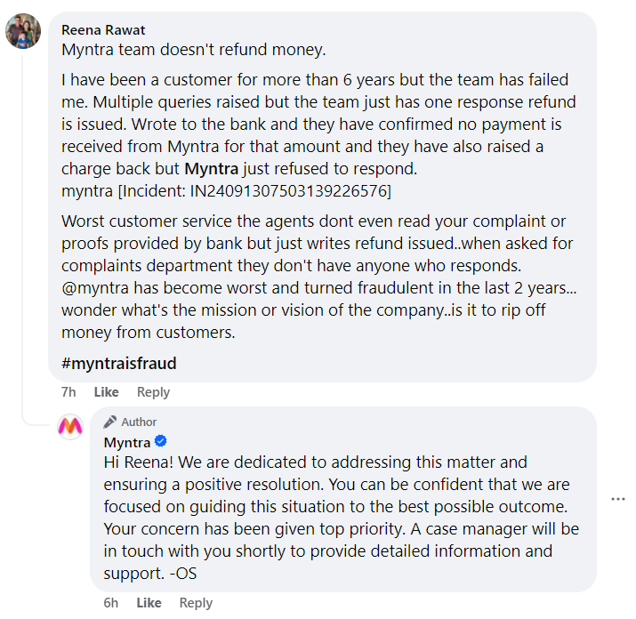
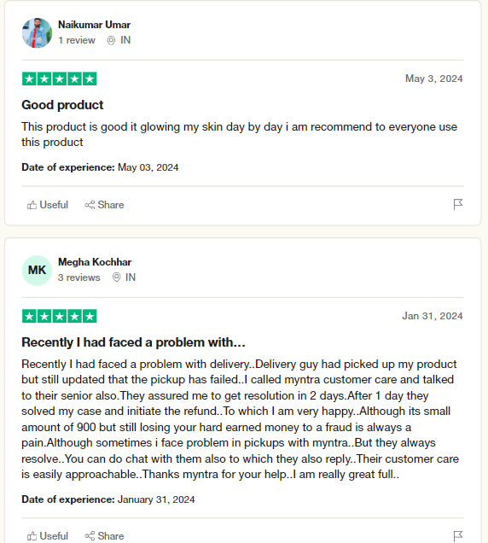
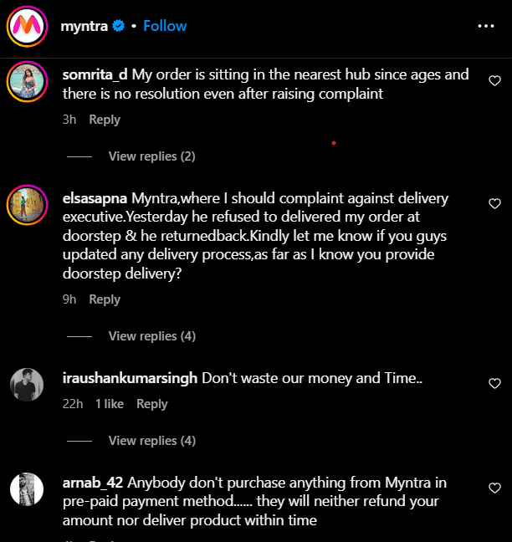
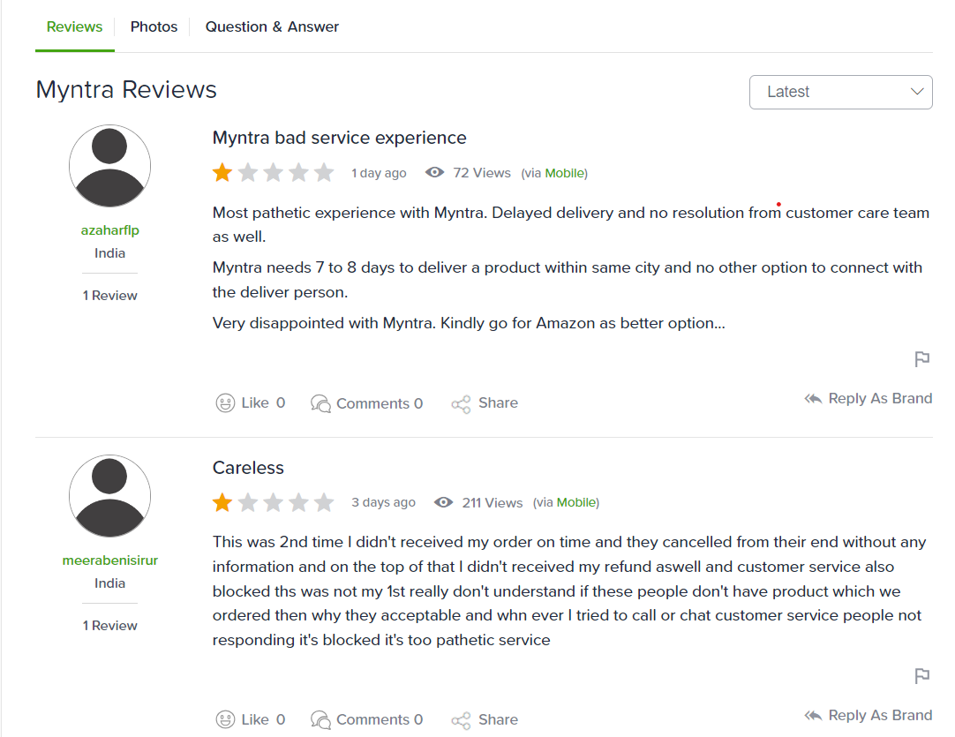
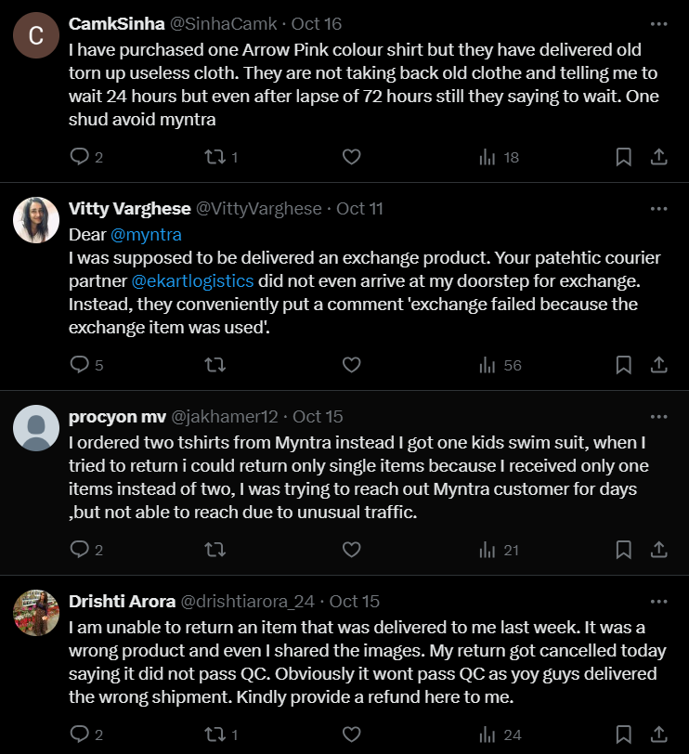
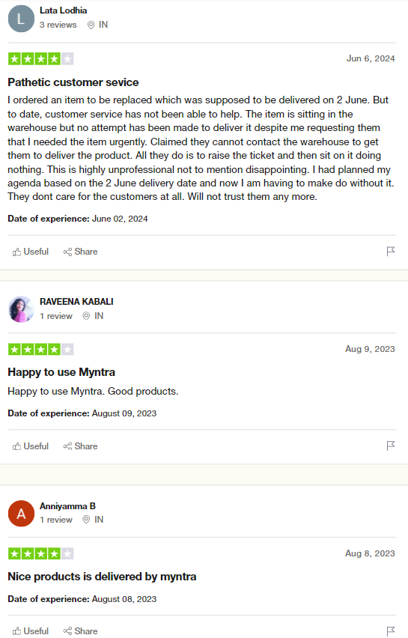
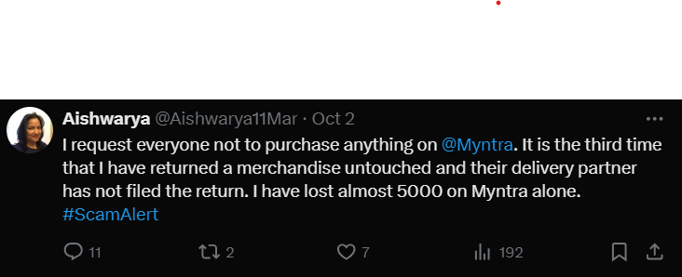
1. Brand Perception Analysis
Searched reviews and comments from the social media platform.
After analyzing the comments , it is observed that the people had positive sentiments in the beginning and gradually it turned into negative.
Positive descriptors: stylish, good quality, right sizes, timely resolutions.
Negative descriptors: poor customer service, confusing policies, untrustworthy, delivery problem, missing myntra credits.

Slide 7
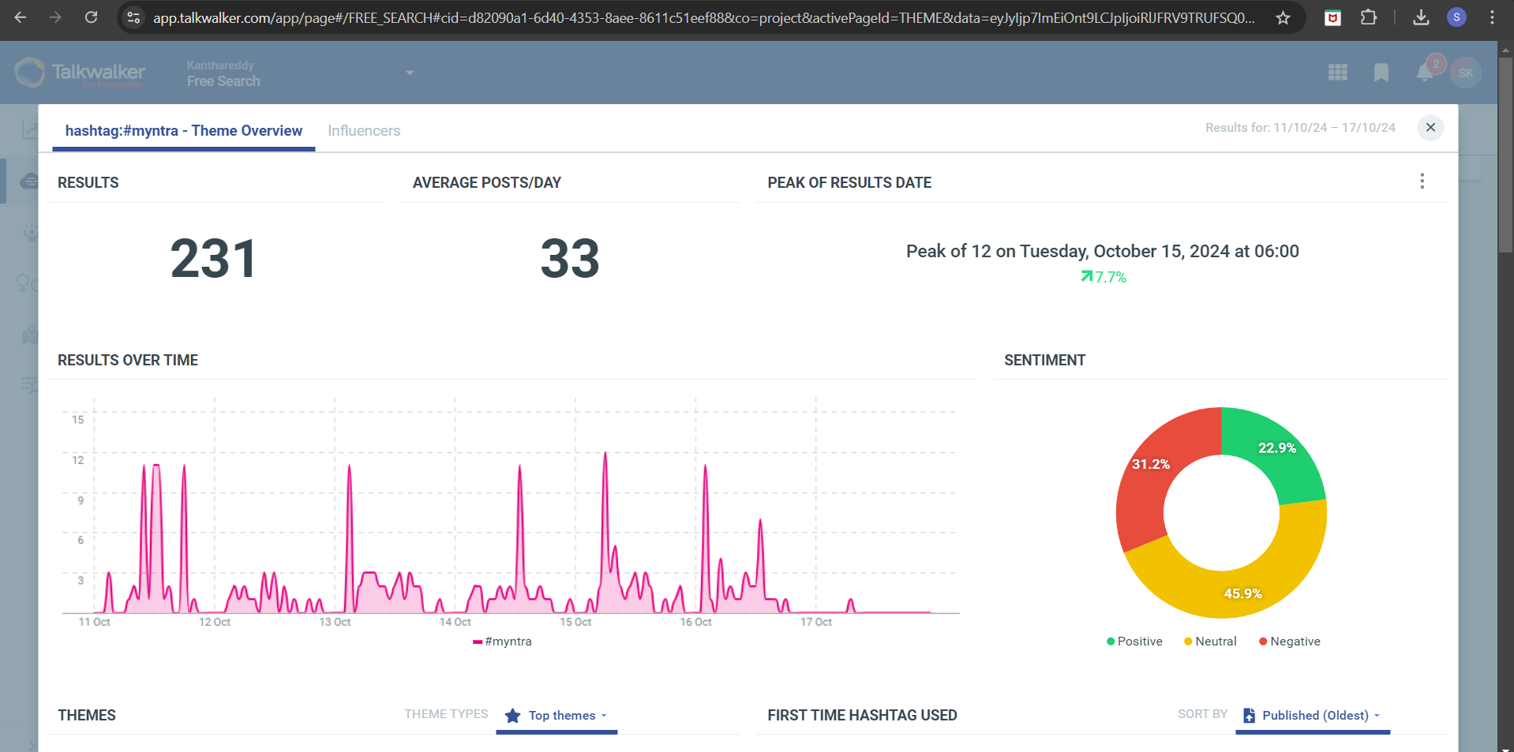
2. Customer Sentiment Analysis
200+ comments have been taken into consideration for this analysis.
Positive sentiments:
Wide range of products
Initial reliability on service and products
Availability of discounts
Stylish and affordable
User-friendly website and app
Negative sentiments:
Poor customer service
Delayed delivery
Unresolved issues
Refund issues
Issues with returning policies
Cancelling the orders
COMMENTS
POSITIVE
NEUTRAL
NEGATIVE

Slide 8
3. Market Trends Identification
Trends
Ethnic Wear
Oversized Outfits
Colours
Sneakers
Urban Street Style
Designer Wear
Festive Wear
Gen-Z trends
Accessories

Slide 9
4. Competitive Landscape Assessment
Top competitors in the fashion market AJIO, Flipkart, Amazon fashion, and Meesho.
Parameters | Myntra | Amazon Fashion | Flipkart | Meesho | Ajio
Market Share | ~20% | ~30 | ~35 | ~10 | ~5
Monthly Active Users | 60 million users | 150 million+ users | 300 million+ users | 15-20 million users | 25 million users
Return Policy | 30- days return policy | 30-days return policy | 10-days return policy | 7-days return policy | 30-days return policy
Customer Reviews | Mixed reviews, often about customer service | High satisfaction, especially with delivery | Generally positive reviews, known for quality and style | Good reviews for affordability | Positive reviews for trendy offerings
Product Range | Ethnic, sportswear, urban outfits, plus sizes | More products but less focus on fashion | Diverse option on clothing and footwear | Focus on low-cost apparels | Focus on trendy and designer wears

Slide 10
5. Strategic recommendations for better market position
Increase supply chain in tier-2 and tier-3 regions.
Affordable delivery charges
Enhance customer support and communication
Delivering the right products
Flexible delivery options
Provide good quality products
Simplified return and refund policies

Slide 11
THANK YOU

